Slide 1
Fabric Demo and usecases
A quick technical walkthrough on Hyperledger Fabric
Live demo on setting up blockchain network
Enterprise blockchain usecases
Lohit Krishnan
lohitkrishnan@in.ibm.com
IBM, India Research Lab, Bangalore
26 March 2019

Slide 2


Hyperledger Fabric V1 Architecture
External-CA
Fabric-CA
optional
Membership
Services
optional
Admin
Peer
Endorser
Client
Application
SDK (HFC)
Committer
O
O
Ledger
Chaincode
A
B
O
O
Events
!
Ordering-Service
Hyperledger Fabric Network

Slide 3
Nodes and roles
 | Peer: Maintains ledger and state. Commits transactions. May hold smart contract (chaincode).
 | Endorsing Peer: Specialized peer also endorses transactions by receiving a transaction proposal and responds by granting or denying endorsement. Must hold smart contract.
 | Ordering Node: Approves the inclusion of transaction blocks into the ledger and communicates with committing and endorsing peer nodes. Does not hold smart contract. Does not hold ledger.
Notes:
Validation role split into 2 independent roles:
Endorsement
Endorsing a transaction verifying that its content obeys a given smart contract. Endorsers “sign” the contract
Ordering
Orders verified transactions for inclusion in the ledger. Controls what goes in the ledger making sure that the ledger is consistent
Introduction of Endorsement Policies and Channels

Slide 4
Hyperledger Fabric Consensus
Endorse
Order
Validate
Consensus is achieved using the following transaction flow:

Slide 5
Sample transaction: Step 1/7 – Propose transaction
Application proposes transaction
Endorsement policy:
“E_{0,} E₁ and E₂ must sign”
(P₃, P₄ are not part of the policy)
Client application submits a transaction proposal for Smart Contract A. It must target the required peers {E₀, E₁, E₂}
E₀
P₃
P₄
A
B
A
D
E₁
Client
Application
SDK
O
O
A
B
E₂
P
O
O
Key:
A
Endorser |  |  | Ledger
Committing Peer |  |  | Application
Ordering Node
Smart Contract (Chaincode) |  |  | Endorsement Policy
B
Ordering-Service
Hyperledger Fabric Network
Notes:
Overview of sample transaction (slides 1-7):
Separation of simulation (chaincode execution) and block validation/commit
Invocation of chaincode operation (business transaction) carried out in 3 phases:
Chaincode operation execution simulated on ‘endorsing’ peers.
Parallel simulation enabled on endorsers for improved concurrency and scalability since the simulation does not update the blockchain state
Simulation determines business tran-proposal: readset/writeset, and broadcasts this to the ordering service.
Tran-proposal is then ordered w.r.t. other tran-proposals and broadcast to commiting peers (includes endorsing peers).
Commiting peers validate tran-proposal.readset has not been modified since simulation, and applies the tran-proposal.writeset ‘atomically’.

Slide 6

Sample transaction: Step 2/7 – Execute proposal
Endorsers Execute Proposals
E₀, E₁ & E₂ will each execute the proposed transaction. None of these executions will update the ledger
Each execution will capture the set of Read and Written data, called RW sets, which will now flow in the fabric.
Transactions can be signed & encrypted
E₀
P₃
P₄
A
B
A
D
E₁
Client
Application
SDK
O
O
A
B
E₂
P
O
O
Key:
A
Endorser |  |  | Ledger
Committing Peer |  |  | Application
Ordering Node
Smart Contract (Chaincode) |  |  | Endorsement Policy
B
Ordering-Service
Hyperledger Fabric Network
Notes:
Overview of sample transaction (slides 1-7):
Separation of simulation (chaincode execution) and block validation/commit
Invocation of chaincode operation (business transaction) carried out in 3 phases:
Chaincode operation execution simulated on ‘endorsing’ peers.
Parallel simulation enabled on endorsers for improved concurrency and scalability since the simulation does not update the blockchain state
Simulation determines business tran-proposal: readset/writeset, and broadcasts this to the ordering service.
Tran-proposal is then ordered w.r.t. other tran-proposals and broadcast to commiting peers (includes endorsing peers).
Commiting peers validate tran-proposal.readset has not been modified since simulation, and applies the tran-proposal.writeset ‘atomically’.

Slide 7
Sample transaction: Step 3/7 – Proposal Response
Application receives responses
RW sets are asynchronously returned to application
The RW sets are signed by each endorser, and also includes each record version number
(This information will be checked much later in the consensus process)
E₀
P₃
P₄
A
B
A
D
E₁
Client
Application
SDK
O
O
A
B
E₂
P
O
O
Key:
A
Endorser |  |  | Ledger
Committing Peer |  |  | Application
Ordering Node
Smart Contract (Chaincode) |  |  | Endorsement Policy
B
Ordering-Service
Hyperledger Fabric Network
Notes:
Overview of sample transaction (slides 1-7):
Separation of simulation (chaincode execution) and block validation/commit
Invocation of chaincode operation (business transaction) carried out in 3 phases:
Chaincode operation execution simulated on ‘endorsing’ peers.
Parallel simulation enabled on endorsers for improved concurrency and scalability since the simulation does not update the blockchain state
Simulation determines business tran-proposal: readset/writeset, and broadcasts this to the ordering service.
Tran-proposal is then ordered w.r.t. other tran-proposals and broadcast to commiting peers (includes endorsing peers).
Commiting peers validate tran-proposal.readset has not been modified since simulation, and applies the tran-proposal.writeset ‘atomically’.

Slide 8
Sample transaction: Step 4/7 – Order Transaction
Responses submitted for ordering
Application submits responses as a transaction to be ordered.
Ordering happens across the fabric in parallel with transactions submitted by other applications
E₀
P₃
P₄
A
B
A
D
E₁
Client
Application
SDK
O
O
A
B
E₂
P
O
O
Key:
A
Endorser |  |  | Ledger
Committing Peer |  |  | Application
Ordering Node
Smart Contract (Chaincode) |  |  | Endorsement Policy
B
Ordering-Service
Hyperledger Fabric Network
(other applications)
Notes:
Overview of sample transaction (slides 1-7):
Separation of simulation (chaincode execution) and block validation/commit
Invocation of chaincode operation (business transaction) carried out in 3 phases:
Chaincode operation execution simulated on ‘endorsing’ peers.
Parallel simulation enabled on endorsers for improved concurrency and scalability since the simulation does not update the blockchain state
Simulation determines business tran-proposal: readset/writeset, and broadcasts this to the ordering service.
Tran-proposal is then ordered w.r.t. other tran-proposals and broadcast to commiting peers (includes endorsing peers).
Commiting peers validate tran-proposal.readset has not been modified since simulation, and applies the tran-proposal.writeset ‘atomically’.

Slide 9
Sample transaction: Step 5/7 – Deliver Transaction
Orderer delivers to committing peers
Ordering service collects transactions into proposed blocks for distribution to committing peers. Peers can deliver to other peers in a hierarchy (not shown)
Different ordering algorithms available:
SOLO (Single node, development)
Kafka (Crash fault tolerance)
E₀
P₃
P₄
A
B
A
D
E₁
*
Client
Application
SDK
O
O
A
B
E₂
P
O
O
Key:
A
Endorser |  |  | Ledger
Committing Peer |  |  | Application
Ordering Node
Smart Contract (Chaincode) |  |  | Endorsement Policy
B
Ordering-Service
Hyperledger Fabric Network
Notes:
Overview of sample transaction (slides 1-7):
Separation of simulation (chaincode execution) and block validation/commit
Invocation of chaincode operation (business transaction) carried out in 3 phases:
Chaincode operation execution simulated on ‘endorsing’ peers.
Parallel simulation enabled on endorsers for improved concurrency and scalability since the simulation does not update the blockchain state
Simulation determines business tran-proposal: readset/writeset, and broadcasts this to the ordering service.
Tran-proposal is then ordered w.r.t. other tran-proposals and broadcast to commiting peers (includes endorsing peers).
Commiting peers validate tran-proposal.readset has not been modified since simulation, and applies the tran-proposal.writeset ‘atomically’.

Slide 10

Sample transaction: Step 6/7 – Validate Transaction
Committing peers validate transactions
Every committing peer validates against the endorsement policy. Also check RW sets are still valid for current world state
Validated transactions are applied to the world state and retained on the ledger
Invalid transactions are also retained on the ledger but do not update world state
E₀
P₃
P₄
A
B
A
D
*
*
*
E₁
Client
Application
SDK
O
O
A
B
*
E₂
P
O
O
Key:
A
Endorser |  |  | Ledger
Committing Peer |  |  | Application
Ordering Node
Smart Contract (Chaincode) |  |  | Endorsement Policy
*
B
Ordering-Service
Hyperledger Fabric Network
Notes:
Overview of sample transaction (slides 1-7):
Separation of simulation (chaincode execution) and block validation/commit
Invocation of chaincode operation (business transaction) carried out in 3 phases:
Chaincode operation execution simulated on ‘endorsing’ peers.
Parallel simulation enabled on endorsers for improved concurrency and scalability since the simulation does not update the blockchain state
Simulation determines business tran-proposal: readset/writeset, and broadcasts this to the ordering service.
Tran-proposal is then ordered w.r.t. other tran-proposals and broadcast to commiting peers (includes endorsing peers).
Commiting peers validate tran-proposal.readset has not been modified since simulation, and applies the tran-proposal.writeset ‘atomically’.

Slide 11
Sample transaction: Step 7/7 – Notify Transaction
Committing peers notify applications
Applications can register to be notified when transactions succeed or fail, and when blocks are added to the ledger
Applications will be notified by each peer to which they are connected
E₀
P₃
P₄
!
!
!
A
B
A
D
E₁
Client
Application
SDK
!
!
O
O
A
B
E₂
P
O
O
!
Key:
A
Endorser |  |  | Ledger
Committing Peer |  |  | Application
Ordering Node
Smart Contract (Chaincode) |  |  | Endorsement Policy
B
Ordering-Service
Hyperledger Fabric Network
Notes:
Overview of sample transaction (slides 1-7):
Separation of simulation (chaincode execution) and block validation/commit
Invocation of chaincode operation (business transaction) carried out in 3 phases:
Chaincode operation execution simulated on ‘endorsing’ peers.
Parallel simulation enabled on endorsers for improved concurrency and scalability since the simulation does not update the blockchain state
Simulation determines business tran-proposal: readset/writeset, and broadcasts this to the ordering service.
Tran-proposal is then ordered w.r.t. other tran-proposals and broadcast to commiting peers (includes endorsing peers).
Commiting peers validate tran-proposal.readset has not been modified since simulation, and applies the tran-proposal.writeset ‘atomically’.

Slide 12
Solution Creation Demo

Slide 13
Demo
BYFN
Prerequisites
Fabric-samples
Binaries and docker images
Crypto Configuration (crypto-config.yaml)
Network Configuration (configtx.yaml)
Generating Orderer Genesis Block
Generating Channel Configuration Transaction
Setup basic docker network
Create/Join Channel
Install/Instantiate Chaincode
CLI interface
Chaincode walkthrough
Balance Transfer App
Multi-Layer Stack – Fabric -> Chaincode -> NodeSDK
Use of NodeSDK – network-config.yaml
Config files to be changed to deploy other chaincode.

Slide 14
Solution Creation Checklist
Understand the problem
Who are the parties involved ?
Which documents gets into blockchain and what are the validation workflows for them?
What are the set of checks/validation done by different parties?
Network Design
Org structure
Number of orgs
Number of peers per org
Number of channels – data privacy
Number of chaincodes – Logic separation
Fabric CA Vs Cryptogen tool ?
Orderer – Solo/Kafka
Chaincode Design (Go/Node/Java)
Designing the logic.
Utilizing rich queries if using couchDB
Pagination (If using UI)
App Layer Design (Node/Java SDK)
Logic bifurcation between CC and AppLayer

Slide 15
Some useful ideas
Read Write Conflicts
Buffer the transactions at the app layer
Blockchain explorer – Fabric blockchain monitoring tool.
Vendoring of chaincode – Package management in golang
Large chaincodes can be split into packages and can be managed using govendor tool
Access Control in Chaincode –
Based on the user’s attribute (Org, OrganizationUnit, ID etc), control access to some functions in chaincode.
https://github.com/hyperledger/fabric/blob/master/core/chaincode/shim/ext/cid/README.md
Alternative Deployment Options –
Kubernetes – IBM Cloud Private
IBM Blockchain Platform

Slide 16
Further Reading
Fabric Node SDK - https://fabric-sdk-node.github.io/release-1.4/index.html
Commercial Paper Demo - https://hyperledger-fabric.readthedocs.io/en/release-1.4/tutorial/commercial_paper.html
Blockchain Explorer - https://github.com/hyperledger/blockchain-explorer
CC Examples –
https://github.com/hyperledger/fabric/tree/release-1.4/examples/chaincode/go
https://github.com/hyperledger/fabric-samples/tree/release-1.4/chaincode
Rocket Chat - https://chat.hyperledger.org/home
Mailing List - https://lists.hyperledger.org/g/fabric

Slide 17
IBM Solutions
Food Trust
TradeLens

Slide 18


Food Trust

Slide 19
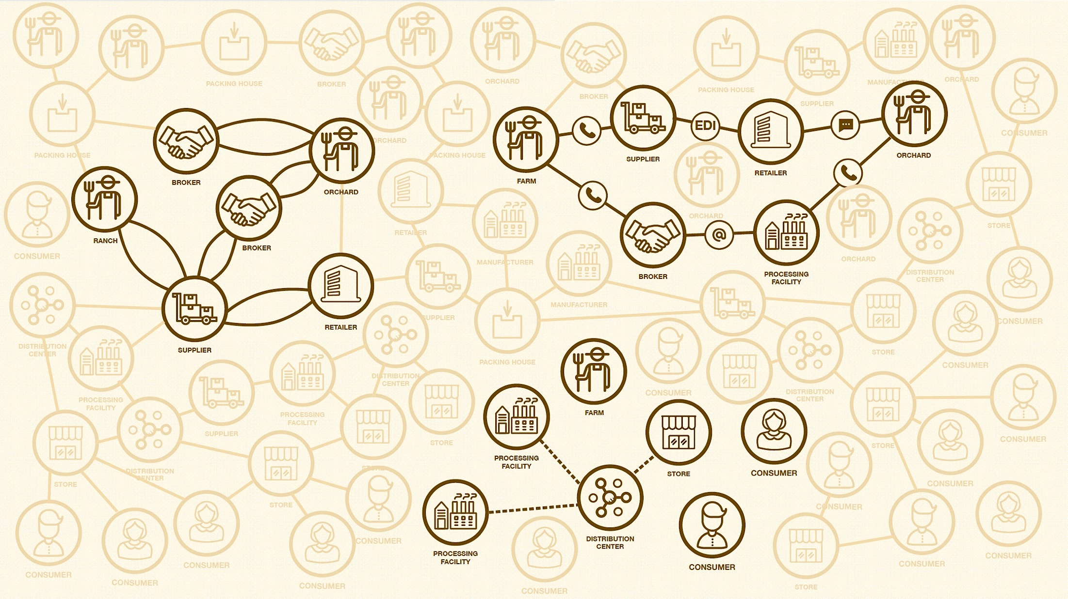

The Food Ecosystem today
Multiple data formats & sources
Lack of trusted, easily auditable records
Data sharing limited to 'one up, one down’ without end-to-end transparency
Incomplete information & inability to effectively communicate with the end consumer
19

Slide 20


Introducing IBM Food TrustTM built on Blockchain technology
The IBM Food Trust solution is a set of modules providing traceability to improve food transparency and efficiency
Blockchain is used to create a trusted connection with shared value for all ecosystem participants, including end consumers
The solution offers connectors for interoperability and leveraging existing standards (e.g., GS1)
Enterprise Ready leveraging the IBM Blockchain Platform to provide enterprise level security and scalability

Slide 21


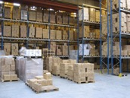
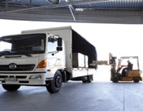
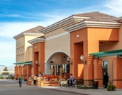




IBM Food Trust provides value to the entire food ecosystem
Prove farm is not a source of outbreak
Ease of connectivity to the supply chain
Instill trust between retails, suppliers & customers
Automate & reduce manual certificate management
Conduct targeted recalls
Enable internal data sharing
Farmers / Producers
Food Manufacturers / CPGs
Wholesalers/ Distributors
Enhance ability to meet compliance standards
Reduce manual processes
Assure customers food supplied is safe
Conduct targeted recalls quickly
Learn about recalls and increased transparency
Reduce risk of being victimized by food fraud
Food Logistics
Food Retailers
Consumers
Reduce fraudulent certificates
Increase renewal speed
Assure customers food supplied Is safe
Reduce wasted food
Identify contamination quickly
Reduce unnecessary testing
Certification Bodies
Food Service
Regulators
Notes:
Recall – Process of retrieving and replacing unsafe goods for consumption.

Slide 22



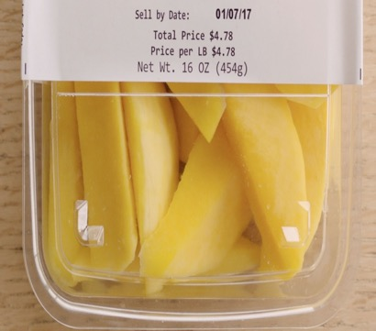


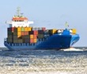
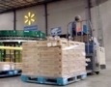
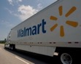
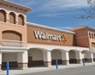

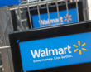
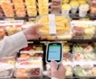
The effectiveness of the IBM Food Trust solution was demonstrated with a Walmart mango pilot
Supply Chain
Pilot Test Case
Results
How long does it take to trace a package of sliced mangoes back to the farm?
Typical manual, mixed digital and paper-based method
6 days
18 hours
26 minutes
IBM Food Trust digital solution
2.2 seconds

Slide 23

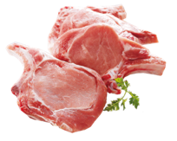
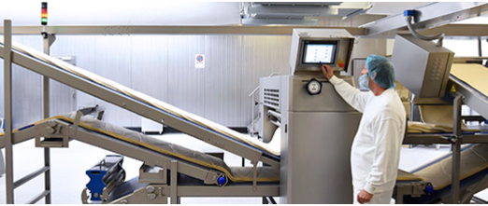










Where are we on our journey?
2016
2017
2018
Additional partners joined the IBM Food Trust™ network, with growing food data transactions
Onboarding agriculture, ingredient suppliers, retailers, CPGs, QSRs and others
conducts traceability pilots
Pork
Traceability / safety
Mango
Traceability / global trade

Slide 24
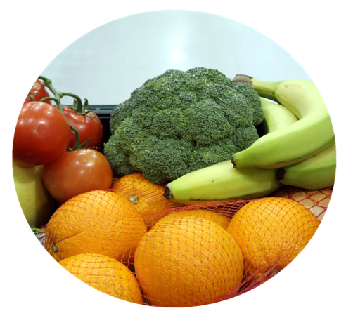
The IBM Food Trust solution is a set of modules built for the industry
Trace & Recall
Data Entry & Access
Certificate Management
Manage Recalls
Recall Post-Analysis
Trace-forward & back
Recall Simulator
IBM Food Trust Solution Core
Version Control
Authenticity
Automated lifecycle management
Real-time Sharing
Permissioned Data Access & Entry
IBM Blockchain Provenance Engine
Secure Document Storage
API Integration
Future 3rd Party Modules / Capabilities
Future IBM Modules
IBM Blockchain Platform
Hyperledger Fabric
Notes:
From the ground up, we built the solution on top of Hyperledger Fabric, which is an open source framework, to support the collaborative development of blockchain-based ledgers. The IBM Blockchain Platform is an enterprise ready blockchain application development solution, from which IBM Food Trust was built.
IBM Food Trust is modular and, in addition to data entry and access, there are two other modules that help to improve food supply chain transparency and efficiency: trace & recall and certificate management. Trace & Recall provides access to end to end food traceability data. Certificate Management gives users the ability to upload, manage, access, and edit compliance documentation over a trusted network.
We also plan to build new modules for additional functionality / capability. But we cannot do it all; what is also important is facilitating an ecosystem model, where anyone can contribute value and extract value. We are working with 3rd party data providers, like food testing companies, hardware device and scanner manufacturers, cold chain operators, and certification bodies and scheme owners to connect the solution to additional source data, to further increase value for participants

Slide 25

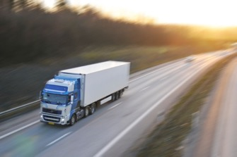

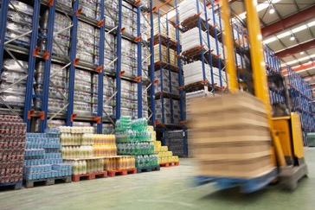
Traceability provides the starting point for other use cases
Freshness Management
Transportation
Optimization
Sustainability
Initiatives
Provenance
Inventory Optimization
Notes:
This is the “BEFORE” picture representing the “status quo” for business networks.
Each participant keeps their own ledger(s) which are updated to represent business transactions as they occur.
This is EXPENSIVE due to duplication of effort and intermediaries adding margin for services.
It is clearly INEFFICIENT, as the business conditions – the contract – is duplicated by every network participant
It is also VULNERABLE because if a central system (e.g. Bank) is compromised due to an incidents this affects the whole business network. Incidents can include fraud, cyber attack or a simple mistake.

Slide 26
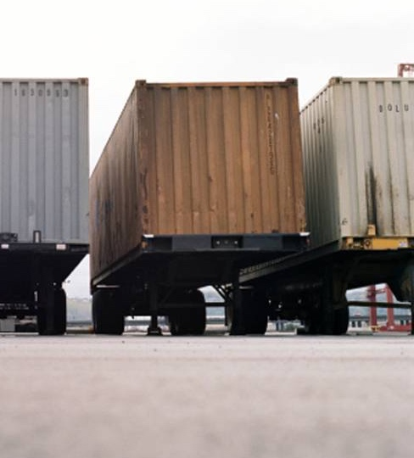
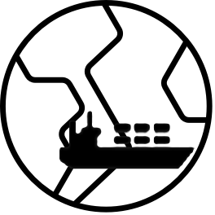
TradeLens
Notes:
Business never operates in isolation. They are participants in a business network.
Business Networks will connect customers, suppliers, banks and regulators and will cross geographical boundaries.
WEALTH is generated as goods and services move across this network; this flow is referred to as a MARKET.
Growth of wealth can be constrained if the network is heavily silo’d or inefficient. Next solution that I am going to discuss is TradeLens. So we are talking about the global trade industry. This is an industry which has seen very less penetration of technology. Still most of the transactions are done using paper work. Global trade as you know is trade between two countries.

Slide 27
IBM and Maersk have launched TradeLens
An open and neutral supply chain platform poised to transform the industry
TradeLens is built for the industry and offers benefits to trade participants from across the supply chain ecosystem
Responding to industry feedback, IBM and Maersk have revised the approach and are proceeding under a Collaboration Agreement, which offers greater flexibility and responsiveness to industry feedback
An Industry Advisory Board will help to shape the platform and drive standards
Maersk Line and Hamburg-Sud are participants under the same terms as other network members
Core platform components are available today under an Early Adopter program; full release remains on target for Q4 2018
Notes:
IBM along with MAERSK a shipping giant, has built a blockchain based solution called TradeLens.

Slide 28

The cost of global trade is estimated at $1.8 trillion annually¹ with potential savings from more efficient processes of ~10%
More than $16 trillion in goods are shipped across international borders each year | 80% of the goods consumers use daily are carried by the ocean shipping industry | By reducing barriers within the international supply chain, global trade could increase by nearly 15%, boosting economies and creating jobs² | In many cases the administrative cost of moving a container is higher than the cost of physically moving it
1) Maersk Strategy Group (May 19, 2016) based on World Bank data for World Trade Costs
2) The World Economic Forum: Enabling Trade Valuing Growth Opportunities 2013
28
Notes:
Let us understand the problem which we are trying to solve.
These are some facts which highlight the pain points in the current trade industry.
Today more than $16 trillion worth of goods are shipped across different countries . 80% of goods which consumers use daily are carried by Ocean Shipping Industry.
Global trade has a cost involved in its entire operations. It is estimated to be around 1.8 Trillion. Of which 10% can be saved by efficient processes.
According a report in the world economic forum, getting this cost down, will help boost the global trade by 15%
The surprising part is – in many cases, the administrative/operational cost for delivering a shipment is much more than the actual physical movement cost.
Typically the shipment from one country to another moves through a channel and the documents have a separate channel since there are lot of approvals which need to be taken from different parties.

Slide 29



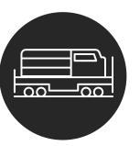
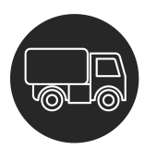


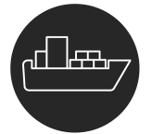
The case for a better way
TODAY
TOMORROW
Open global trade digitization platform
Authority
Consignee
Exporter
Authority
Authority
Forwarder
Exporter
Trucker
Rail
Forwarder
Consignee
Terminal
Authority
Authority
Carrier
Terminal
Authority
Authority
Carrier
Inconsistent information across organizational boundaries and “blind spots” throughout the supply chain hinder the efficient flow of goods
Complex, cumbersome, and costly peer-to-peer messaging
Manual, time-consuming, paper-based processes
Risk assessments often lack sufficient information; clearance processes subject to fraud
The administrative cost of handling a container shipment is comparable to the cost of the actual physical transport
Instant, secure access to end-to-end supply chain information; single source of the truth
Assurance of the authenticity and immutability of digital documents
Trusted cross-organizational workflows
Better risk assessments and fewer unnecessary interventions
Far lower administrative expenses and elimination of costs to move physical paper across international borders

Slide 30

















The TradeLens Platform
Digitizing the global supply chain
Inland Transportation
Connects the ecosystem Brings together all parties in the supply chain - including traders, freight forwarders, inland transportation, ports and terminals, ocean carriers, customs and other government authorities, and others - onto a Blockchain-based platform with a secure permission and identity framework Drives true information sharing Provides for the seamless, secure sharing of real-time, actionable supply chain information across all parties to a trade - encompassing shipping milestones, cargo details, trade documents, the structured data embedded in trade documents, customs filings, sensor readings, and more Fosters collaboration and trust Enables the digitization and automation of the cross-organization business processes integral to global trade, including import and export clearance, with Blockchain ensuring secure, auditable, and non-repudiable transactions Spurs innovation Lays the foundation for ongoing improvement and innovation through an open, non-proprietary API, the use of standards and promotion of interoperability, and the launch of an Applications Marketplace that parties can use to build and deploy TradeLens-powered applications for themselves, their partners, and their customers
Customs Brokers
Shippers / Beneficial Cargo Owner
Supply Chain Visibility Systems
Customs Systems
Ports and Terminals
THE PLATFORM IS BUILT ON AN OPEN TECHNOLOGY STACK AND IS UNDERPINNED BY BLOCKCHAIN TECHNOLOGY
Trade Associations
Supply Chain / Transportation Management Systems
Ocean Carriers
Freight Forwarders / 3PLs
Authorities
Port Community Systems; Terminal Operating Systems
Financial / Insurance Services
Notes:
What does TradeLens provide

